Slide 1
hwdbg
Debugging Hardware Like Software
Sina Karvandi
Spring 2024

Slide 2
“To err is human, to debug is divine.”

Slide 3




hwdbg is a new debugger chip generator based on chisel language (scala) & LLVM circt
hwdbg.hyperdbg.org/docs

Slide 4

Outline
01 Introduction
02 Design
03 Sensors
04 Scripting Language
05 D.F.R.
06 Evaluation
Questions

Slide 5
Outline
01 Introduction
What is HyperDbg?
Main Motivation
Key Contributions
Software, Hardware Platform
Key Features
Debugging Modes
02 Design
03 Sensors
04 Scripting Language
05 D.F.R.
06 Evaluation
Questions

Slide 6
Introduction
01
The motivation behind creating a new debugger

Slide 7
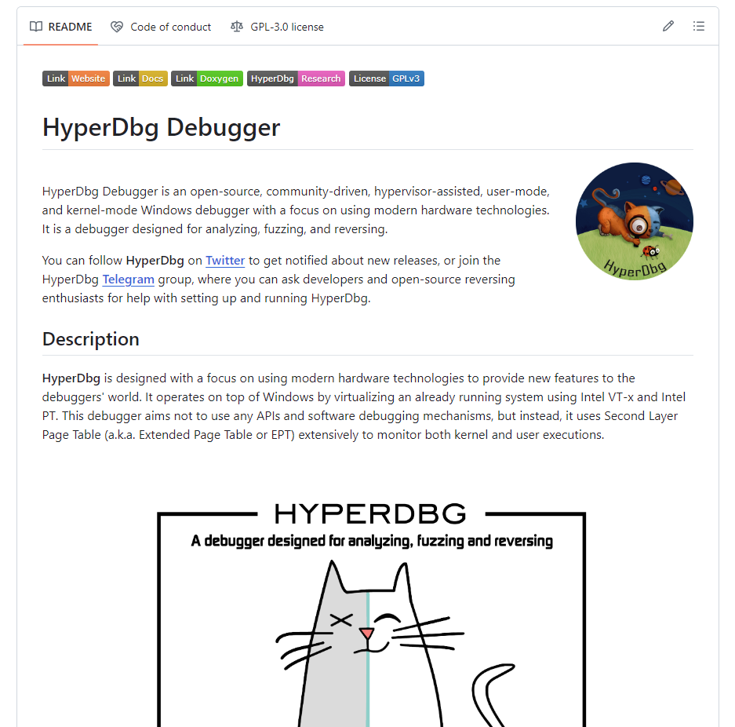
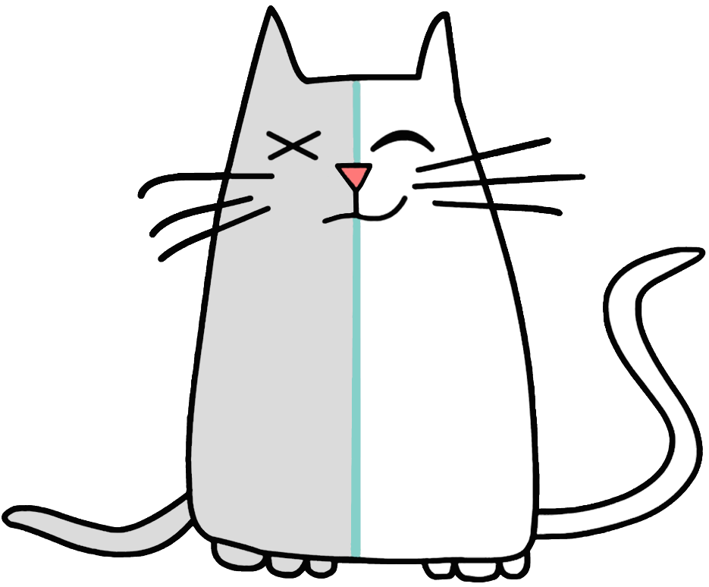
What is HyperDbg?
HyperDbg is an open-source platform that brings debugging infrastructures like hypervisor-assisted, user-mode, and kernel-mode debuggers mainly with a focus on using modern hardware technologies for analyzing, fuzzing, and reversing.

Slide 8
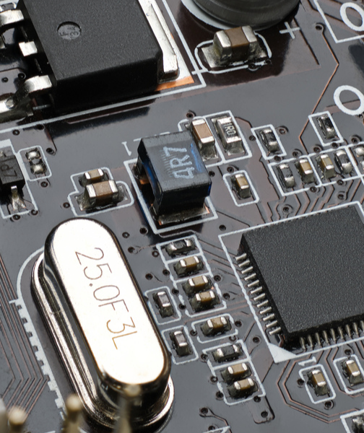
Main Motivation
The key intuition behind hwdbg is making security researchers and hardware engineers able to run custom action in the smallest (shortest) event in a digital circuit which is the changes (rising-edge & falling-edge) within the clock cycle.

Slide 9
Key Contributions
Introduction of a Unified Debugging Framework
Open-source and Customizable Tool
Integration with FPGAs
Robust Debugging Experience
Enhancement of Reverse Engineering and Chip Fuzzing Capabilities
Comprehensive Scripting Support
hwdbg comes with these contributions.

Slide 10
01
02
03
Software
Hardware
Platform
The software side is implemented in C/C++ for sending debugging commands and parsing scripts.
The hardware side will be written in chisel programming language as well as Verilog and SystemVerilog.
The testing platform is AMD Xilinx FPGAs.

Slide 11
Key Features
Signal Analyzer
Testing & Fuzzing
Software Abstractions
Signal Manipulator
An open-source logic analyzer
Automatic testing and fuzzing of chips by software generated testcases
Simulate software debugging concepts in hardware
Manipulating digital signals by changing the state of wires

Slide 12
Debugging Modes
Passive debugging
Active debugging
In this debugging mode, hwdbg acts as an introspection tool, and monitors different signals to the target debugging module.
In this debugging mode, hwdbg is able to both monitor and manipulate signals (Input/Output). These signal modifications are configured by the user’s custom scripts.

Slide 13
Outline
01 Introduction
02 Design
PS <> PL Communication
Communication Modules
Input/Output Ports
BRAM Simulator
BRAM Simulator Waves
03 Sensors
04 Scripting Language
05 D.F.R.
06 Evaluation
Questions

Slide 14
Design
02
The proposed debugger chip generator design

Slide 15
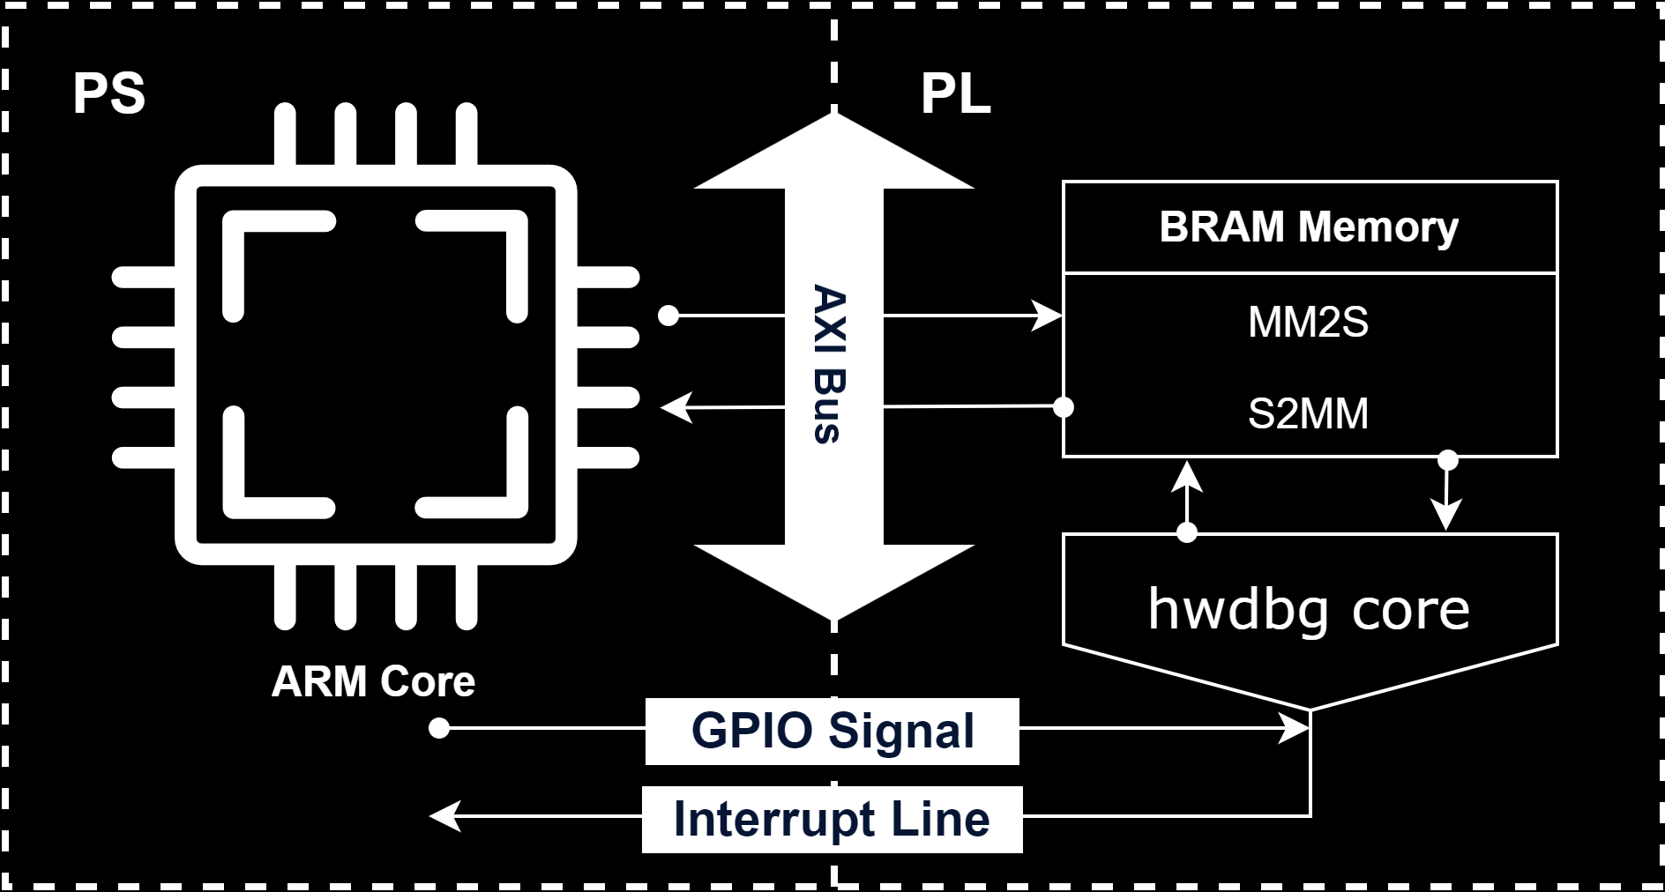
PS <> PL Communication
hwdbg communicates from PS to PL by using a shared BlockRAM over the AXI bus, as well as an interrupt line from PL to PS and a shared GPIO line from PS to PL.

Slide 16
Communication Modules
—Sending Module
—Receiving Module
—Send/Receive Synchronization Module
—Interpreting Module
Sending module is responsible for preparing mandatory headers and write to BRAM as well as interrupting PS.
Once share PS <> PL line is high, receiving verifies BRAM data headers and notifies interpreter.
Because only one BRAM port is shared with PL, synchronization is needed to avoid data corruption in case of simultaneous writes.
Once a valid packet is received, the interpreting module configures the chips and sends the response to the debugger.

Slide 17

Input/Output Ports
This picture illustrates the input/output pins of the hwdbg design.

Slide 18
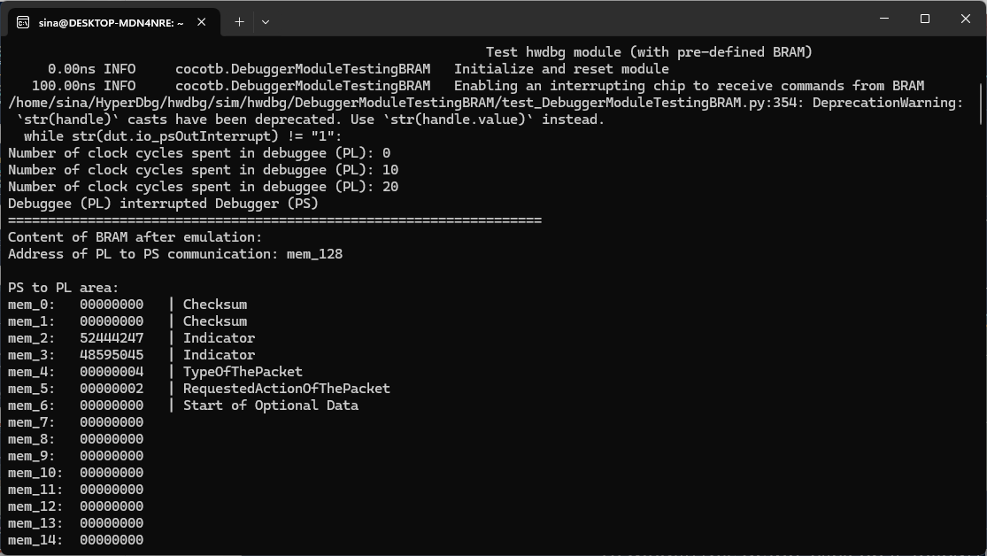
BRAM Simulator
Here is the BRAM simulator (PS to PL area).

Slide 19
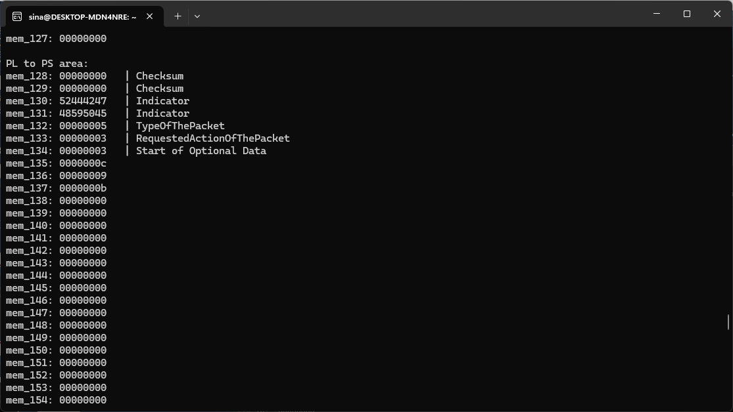
BRAM Simulator (cont.)
Here is the BRAM simulator (PL to PS area).

Slide 20
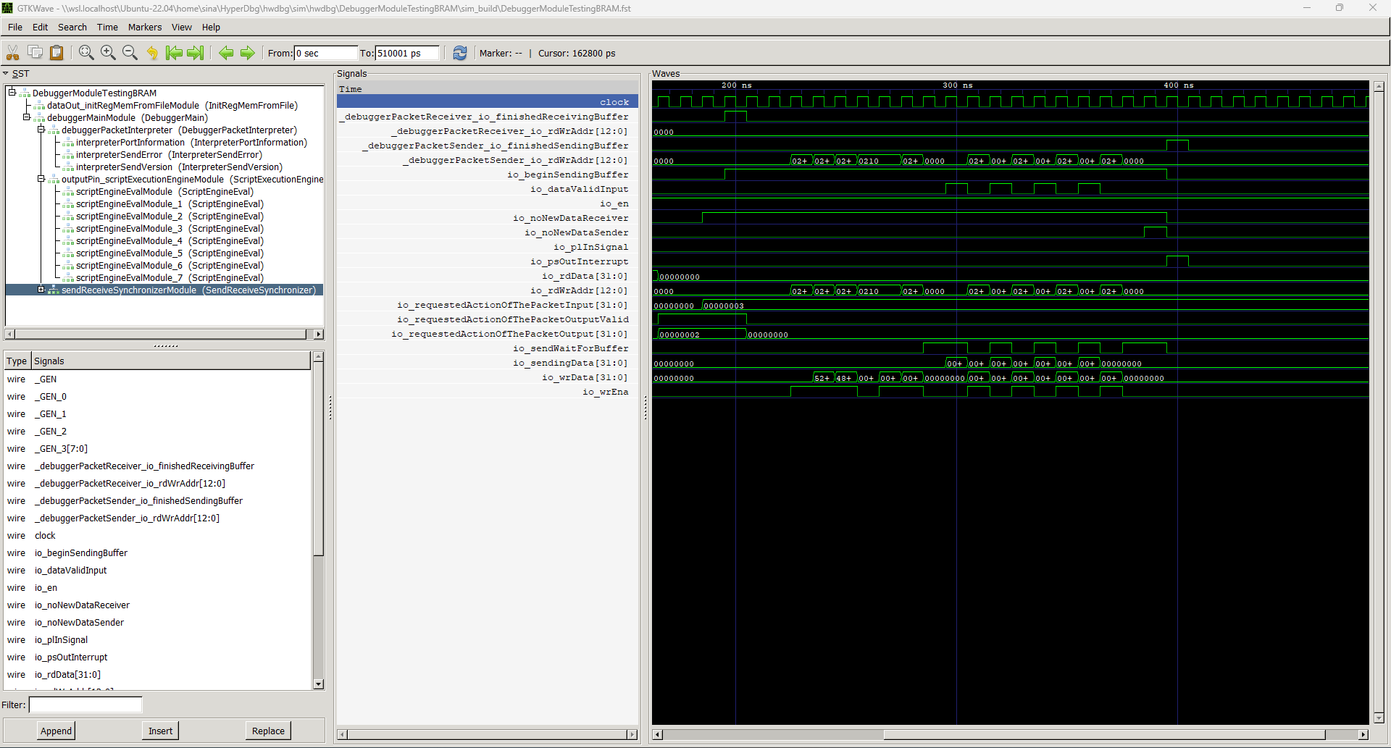
BRAM Simulator Waves
Here is the BRAM simulator wave results for hwdbg.

Slide 21
Outline
01 Introduction
02 Design
03 Sensors
Side-channel Attacks in Microchips/IP Cores
Physical Unclonable Function (PUF)
Debugging Sensors
04 Scripting Language
05 D.F.R.
06 Evaluation
Questions

Slide 22
Sensors
03
The debugging sensor modules embedded in the hwdbg debugger

Slide 23
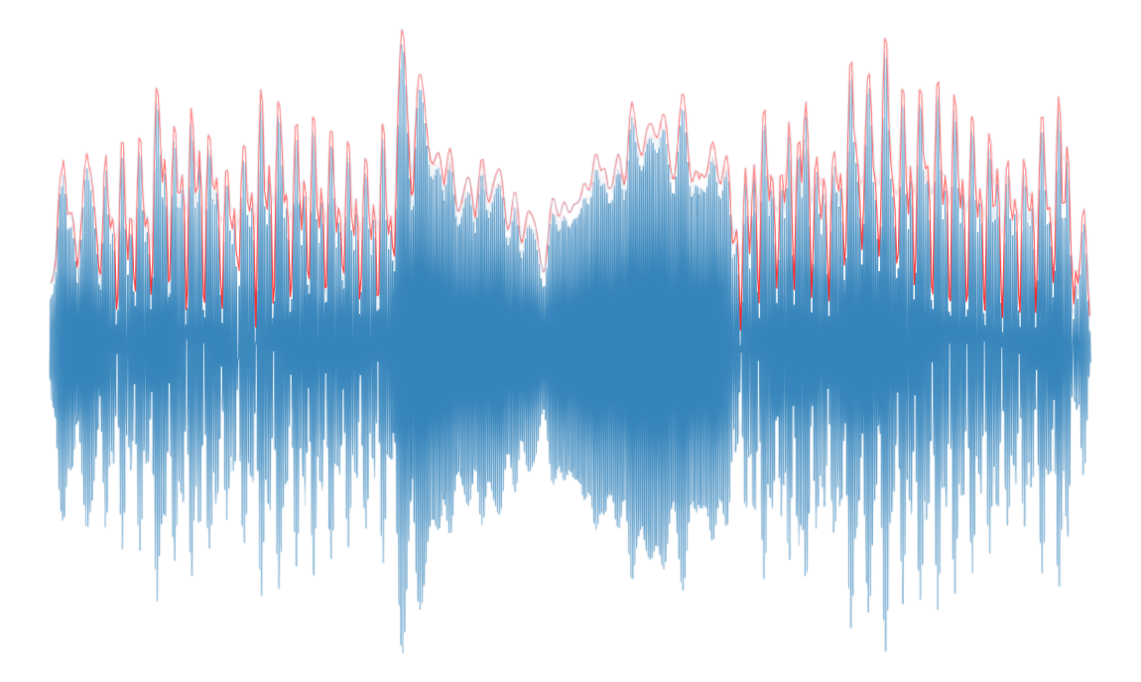
Side-channel Attacks in Microchips/IP Cores
A side-channel attack in chips and IP cores involves exploiting indirect information leakage, such as power consumption or electromagnetic emissions, to extract sensitive data.
We use sensors like Ring Oscillators (RO) for detecting these side channels because they can monitor variations in hardware characteristics, which may indicate the presence of side-channel leakage or attacks.

Slide 24
PUF
Physical Unclonable Function
A PUF is a physical entity utilized in microchips and other electronic devices to generate unique, device-specific cryptographic keys based on the uncontrollable physical variations that occur during the manufacturing process.
These unique differences, such as variations in silicon pathways, ensure that each PUF is unique and make it theoretically impossible to duplicate or clone.

Slide 25
Debugging Sensors
Ring Oscillator (RO)
IDELAYE2/3
Time-to-Digital Converter (TDC)
Measures variations in signal propagation delay to detect changes in environmental conditions or circuit behavior.
Provides adjustable signal delay capabilities for timing adjustments and alignment in high-speed circuits.
Converts the time interval between two events into a digital value for precise timing measurements.

Slide 26
Debugging Sensors (cont.)
Voltage Sensor
Frequency & Clock Sensors
Temperature Sensor
Monitors and measures the voltage levels within a circuit to ensure stable and correct operation.
Monitors the frequency and stability of clock signals to ensure they remain within the expected range and performance criteria.
Measures the temperature within the chip to monitor thermal conditions and prevent overheating.

Slide 27
Outline
01 Introduction
02 Design
03 Sensors
04 Scripting Language
Script Execution Stages
Ports & Pins
Supported Statements
Supported Operators
Example Script 1
Example Script 2
05 D.F.R.
06 Evaluation
Questions

Slide 28
Scripting Language
04
HyperDbg’s dslang variation for hardware debugging

Slide 29
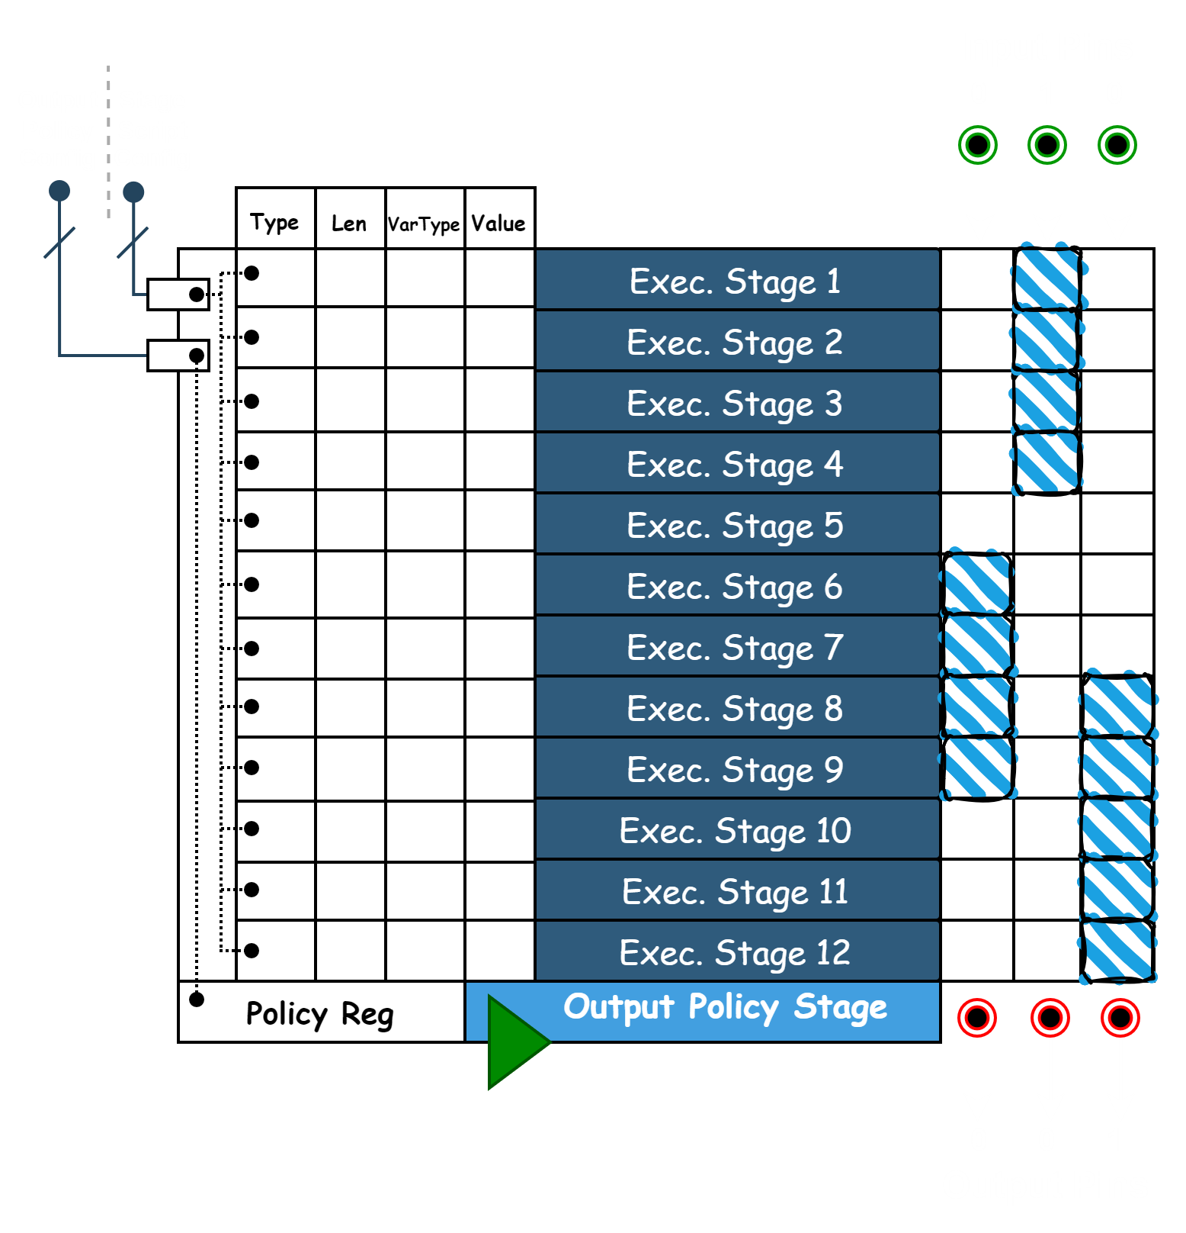
Script Execution Stages
This picture demonstrates the execution of different IR scripts in each stage.

Slide 30
Ports & Pins
Registers | Pseudo-registers
@hw_pin0 | $hw_clk, or $hw_clock: 1 or 0
@hw_pin1 | $hw_counter and, $hw_clock_edge_counter
@hw_pinX | $hw_clock_frequency
@hw_port0 | $hw_stage: Stage number of script
@hw_port1
@hw_portX

Slide 31
Supported Statements
Changing pins and ports (registers) and assign to variables
Modifying the BRAM memory
Defining custom function
Memory Modification
Register and Variable Assignment
Functions
External Argument
Conditional Statements
Arguments as $arg0, $arg1, etc.
if, else, elsif statements

Slide 32
Supported Operators
Precedence | Operators
Parentheses | ( )
Unary Operators | -, +, ~, &, *
Arithmetic Operators | *, /, %
Arithmetic Operators | +, -
Shift Operators | >>, <<
Comparison Operators | >=, <=, >, ==, !=
Bitwise AND Operator | &
Bitwise XOR Operator | ^
Logical AND Operator | &&
Logical OR Operator | ||

Slide 33
Example Script 1
? {
if (@hw_port5 == 55) {
printf(“@hw_port5 is equal to 0x55\n");
}
elsif(@hw_port5 == 66) {
printf(“@hw_port5 is equal to 0x66\n");
}
elsif(@hw_port5 == 77) {
printf(“@hw_port5 is equal to 0x77\n");
} else {
printf(“@hw_port5 is not equal to 0x55, 0x66, 0x77. It is equal to %llx\n", @hw_port5);
}
}

Slide 34
Example Script 2
? {
int my_func1(int var1) {
result = var1 + 1;
printf("my_func1 %d\n", result);
return result;
}
int my_func2(int var1) {
result = var1 * 2;
printf("my_func2 %d\n", result);
return result;
}
int my_func3(int var1) {
result = my_func1(var1) + my_func2(var1);
printf("my_func3 %d\n", result);
return result;
}
printf("%d\n", my_func3(2));
}

Slide 35
Outline
01 Introduction
02 Design
03 Sensors
04 Scripting Language
05 D.F.R.
Key (must-have) Software Debugger Features
Debugging Hardware Like Software
Software Stepping in Hardware
Anomaly Definition
Fuzzing & Fault-Injection
06 Evaluation
Questions

Slide 36
D.F.R.
05
Debugging, Fuzzing, Reversing

Slide 37

Key (must-have) Software Debugger Features
Reading/Writing Memory
Inspecting/Modifying Registers Values
Stepping Through Instructions
Putting Breakpoints and Pausing The Debuggee

Slide 38
Debugging Hardware Like Software
Emulation of Instruction Stepping by Controlling Clock Signal
Logic Analyzer
Signal Inspection and Modification
Cutting The Signals Based on Conditions
Putting Breakpoints and Pausing The Debuggee
Inspecting/Modifying Registers Values
Reading/Writing Memory
Stepping Through Instructions

Slide 39
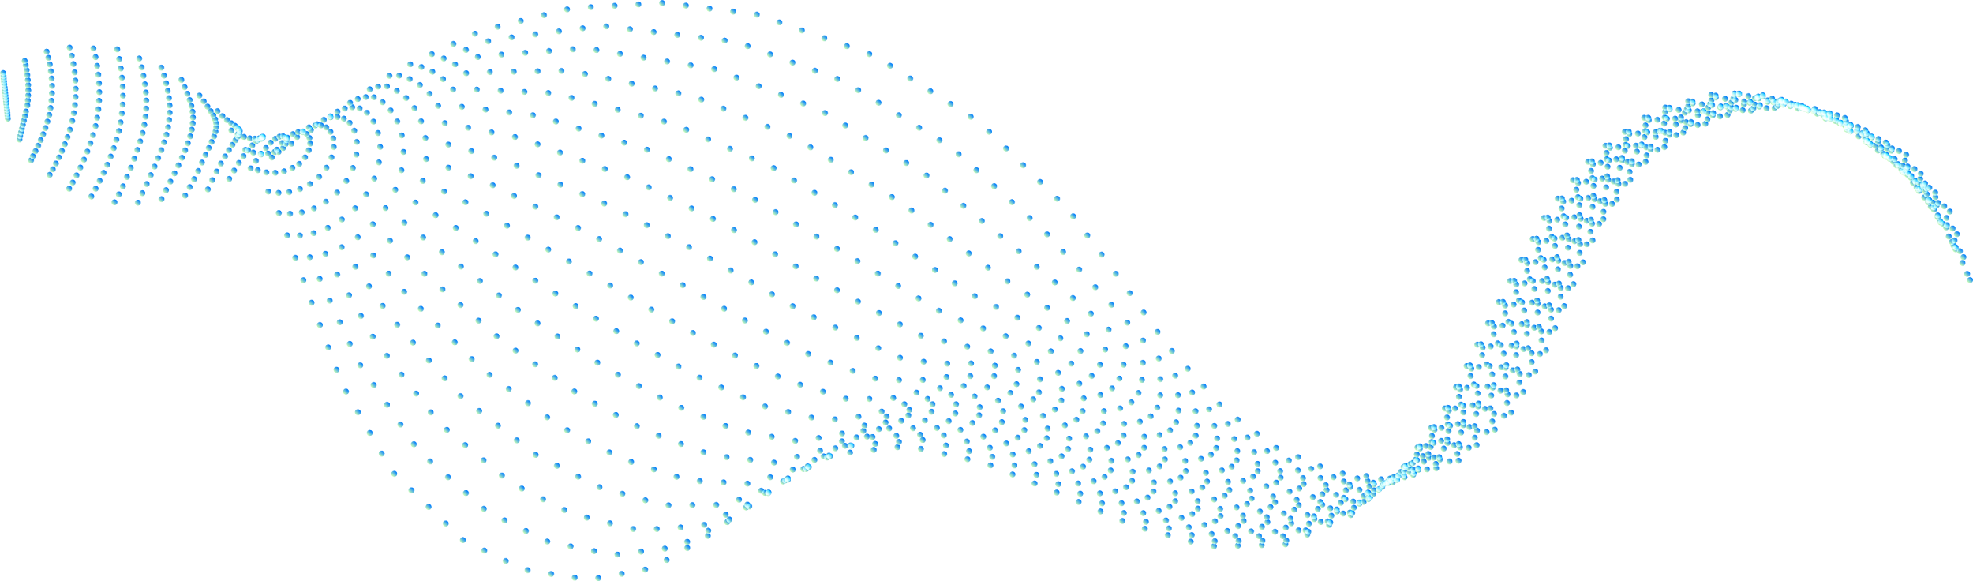



Software Stepping in Hardware
Once we can control the clock signal, we are able to see and modify I/O ports at each cycle.
The next rising-edge clock will be inserted once the introspection/modification is done.
Not possible in chips with internal clock sources.

Slide 40
Anomaly Definition
Anomalies In Expected Functionalities
Anomalies Based On Sensors Indications
These occur when the device fails to compute the correct output due to specific inputs, detectable through emulation.
Sensors can indicate anomalies through abnormal state changes, signaling potential internal issues in the chip.

Slide 41
Fuzzing & Fault-Injection
Change Clock domain
Fuzzing
Cut Singal
Using PWM with different duty cycles
Providing random software generated data and observe the output
Remove signal at different random stages

Slide 42
Outline
01 Introduction
02 Design
03 Sensors
04 Scripting Language
05 D.F.R.
06 Evaluation
dslang vs. TSM
Source code
Questions

Slide 43
Evaluation
06
Evaluating hwdbg debugger chip generator

Slide 44
dslang vs TSM
 | hwdbg (dslang) | Xilinx ILA (TSM)
Can act as a logic analyzer | Yes | Yes
Speed comparison | Slower | Faster
Can trigger an event (e.g., a breakpoint) | Yes | Yes
Has debugging sensors | Yes | No
Can modify signals on the fly (configurable) | Yes | No
Can interpret complex computations | Yes | No
Supports on-the-fly configuration | Yes | No
Notify the debugger without triggering event | Yes | No
Supports software stepping | Yes | No
Simplicity of state machine scripting | Simpler, software-like scripting | More complex
Can perform stepping fault-injection and signal manipulation | Yes | No
Can perform active debugging (producing fuzzing signals) | Yes | No

Slide 45
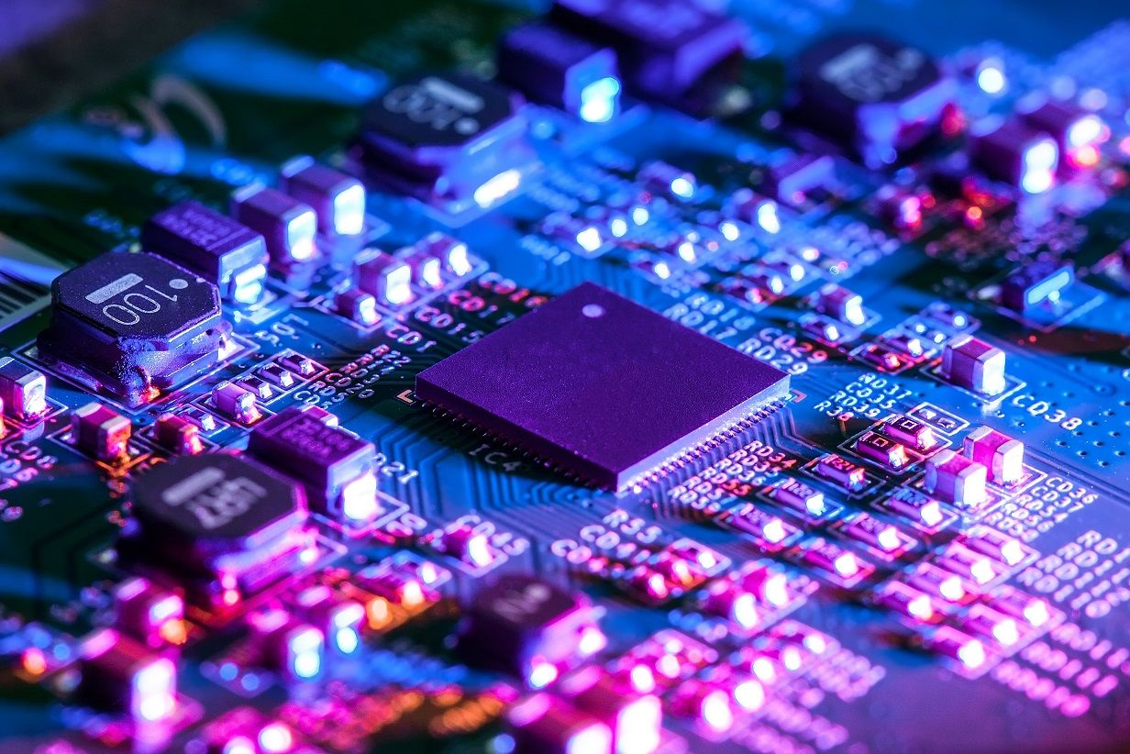
hwdbg is available at: https://github.com/HyperDbg/hwdbg

Slide 46
Questions
Any questions?

Slide 47
Thank you!
Do you have any questions?
Mail: sina@hyperdbg.org
Twitter: @Intel80x86
Blog: rayanfam.com
or
https://github.com/orgs/HyperDbg/discussions

